Slide 1



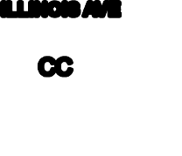




Zoning Map
LI
BARONI RD
DALE ST
WATSON RD
HWY 74
ADAMS AVE
GV-SP (BPO)
LI
MONROE AVE
CASE RD
1ST ST
GV-SP (BPO)
N I 215
ILLINOIS AVE
JACKSON AVE
CC
LI
VAN BUREN AVE
GREEN VALLEY P^{KWY}
GV-SP (Commercial)
S I 215
HARRISON AVE
PROJECT
SITE
TRUMBLE RD
CC
GV-SP (Commercial)
SHERMAN RD
TYLER AVE
ETHANAC RD
CC
3RD ST
CC
BARNETT RD
ENCANTO DR
CC
CC
9/20/2024, 1:31:17 PM
1:11,296
0.15
Parcels Zoning
Commercial Community (CC)
Green Valley Specific Plan Business Professional Office(GV-SP BPO) Green Valley Specific Plan Commercial (GV-SP Commercial)
Green Valley Specific Plan Multi-Family (GV-SP MF) Green Valley Specific Plan Open Space (GV-SP OS) Light Industrial (LI)
Public (P) Perris Boundary
0
0.07
0.3 mi
0
0.13
0.25
0.5 km
Nearmap

